Slide 1
Transformation Product Billing North Star
TAI Systems Planning
March 2021

Slide 2


Executive Summary
The position of Transformation products billing direction, with consideration of a tactical approach to align a strategically federated billing platform model for cross LOBs
Opportunity
Conclusions
Recommendations
Client expect a single bill from CVS, but may receive multiple bills due to more products purchased
Manual work of product business and billing teams to facilitate billing details before billing system to produce correct invoices
Discovery assessment identified variabilities of billing specificities, unique business rules, how product sold by dependency or independency that are difficult to harmonize billing
Multiple disjoint billing systems cross LOBs and enterprise depend on market, products, etc.
Variations in each product billing dates (begin vs. middle of month), billing terms (PEMPM, PMPM, etc.) and calculate cycle (pre or after program start) are challenge factors to consolidate
Caremark billing mostly focus on SAP
HCB billing is EBS (Commercial group), and Medicare NG Market Prominence
Transformation billing has added complexity due to multiple different types of billing scenarios and how they are sold in combination with other lines of business products
Leverage SAP to consolidate all new non-Native Transformation product billing
Leverage existing billing systems for Caremark, HCB and AHM customers
Consolidate results into a single reporting solution for all Transformation billing
Identify opportunities across manual billing processes to provide greater automation where possible
Establishing a single enterprise billing solution is not cost justified at this time

Slide 3
Business Opportunity
The New Payor Agnostic products created in Transformation require streamlined billing process that is consistent cross LOB in order to deliver the consolidated Payor (plan sponsor) invoice
Business Opportunity
Plan Sponsor and Payor experience | Receive timely and accurate invoices Have a clear and consolidated view of all purchased CVS products Access to simple and flexible payment mechanisms
Operational billing process | Automate manual processes and cross team workflows Reduce turn around time and complexity of billing processes Improve accuracy and eliminate errors
Reporting and insights | Enable centralize billing dashboard across all customer billing systems Improving understanding of billing activity, backlog and opportunity areas Able to respond quickly with actionable insights

Slide 4
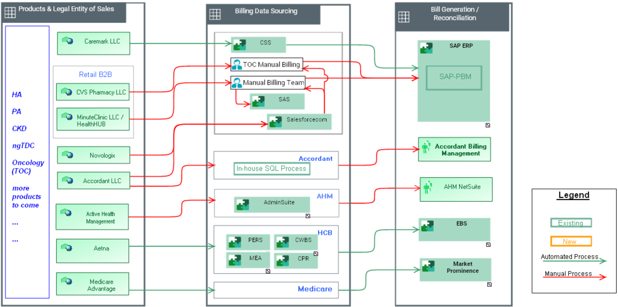
Where are we today?
Multiple fabricated processes of billing for the same product across different LOBs, multiple billing technologies across the Enterprise present many challenges to accomplish a consolidated billing
Current State

Slide 5
What are the current state challenges?
Multiple legal entities sell Transformation product; each team collect data and process billing using different workflow and hand off to different systems. Processes have no consistent reporting and lack cross product visibility
Description of Transformation billing scenario
Product sale
Data sourcing
Prepare bill
Process bill
Reporting
What’s happening
Multiple teams sell the same product under different legal entities
Product activity and data are collected from different workflows through manual processes
Data hands offs and manual data replication between product and billing teams
Multiple separate systems to produce client invoice and manage AR functions
Manually pull and translate data from one systems to another for reporting
Business rules
Speed
Data quality
Experience
Visibility
What are the challenges
Duplication of effort for a given product
Potential different business rule for the same product
Time consuming to collect source data using different tools and processes
Data quality is subject to human error
Payor / Plan Sponsor may receive multiple bills for different products purchased
No centralized reporting view across the billing systems for Transformation products
Systems
Data input
Traceability
Duplication
Insight
Keep multiple systems synchronized
Lack of automation
Lack of visibility for error detection
No mechanism to support a single bill for the Transformation products
Disjoint systems require manual aggregation for business insights
System implications

Slide 6
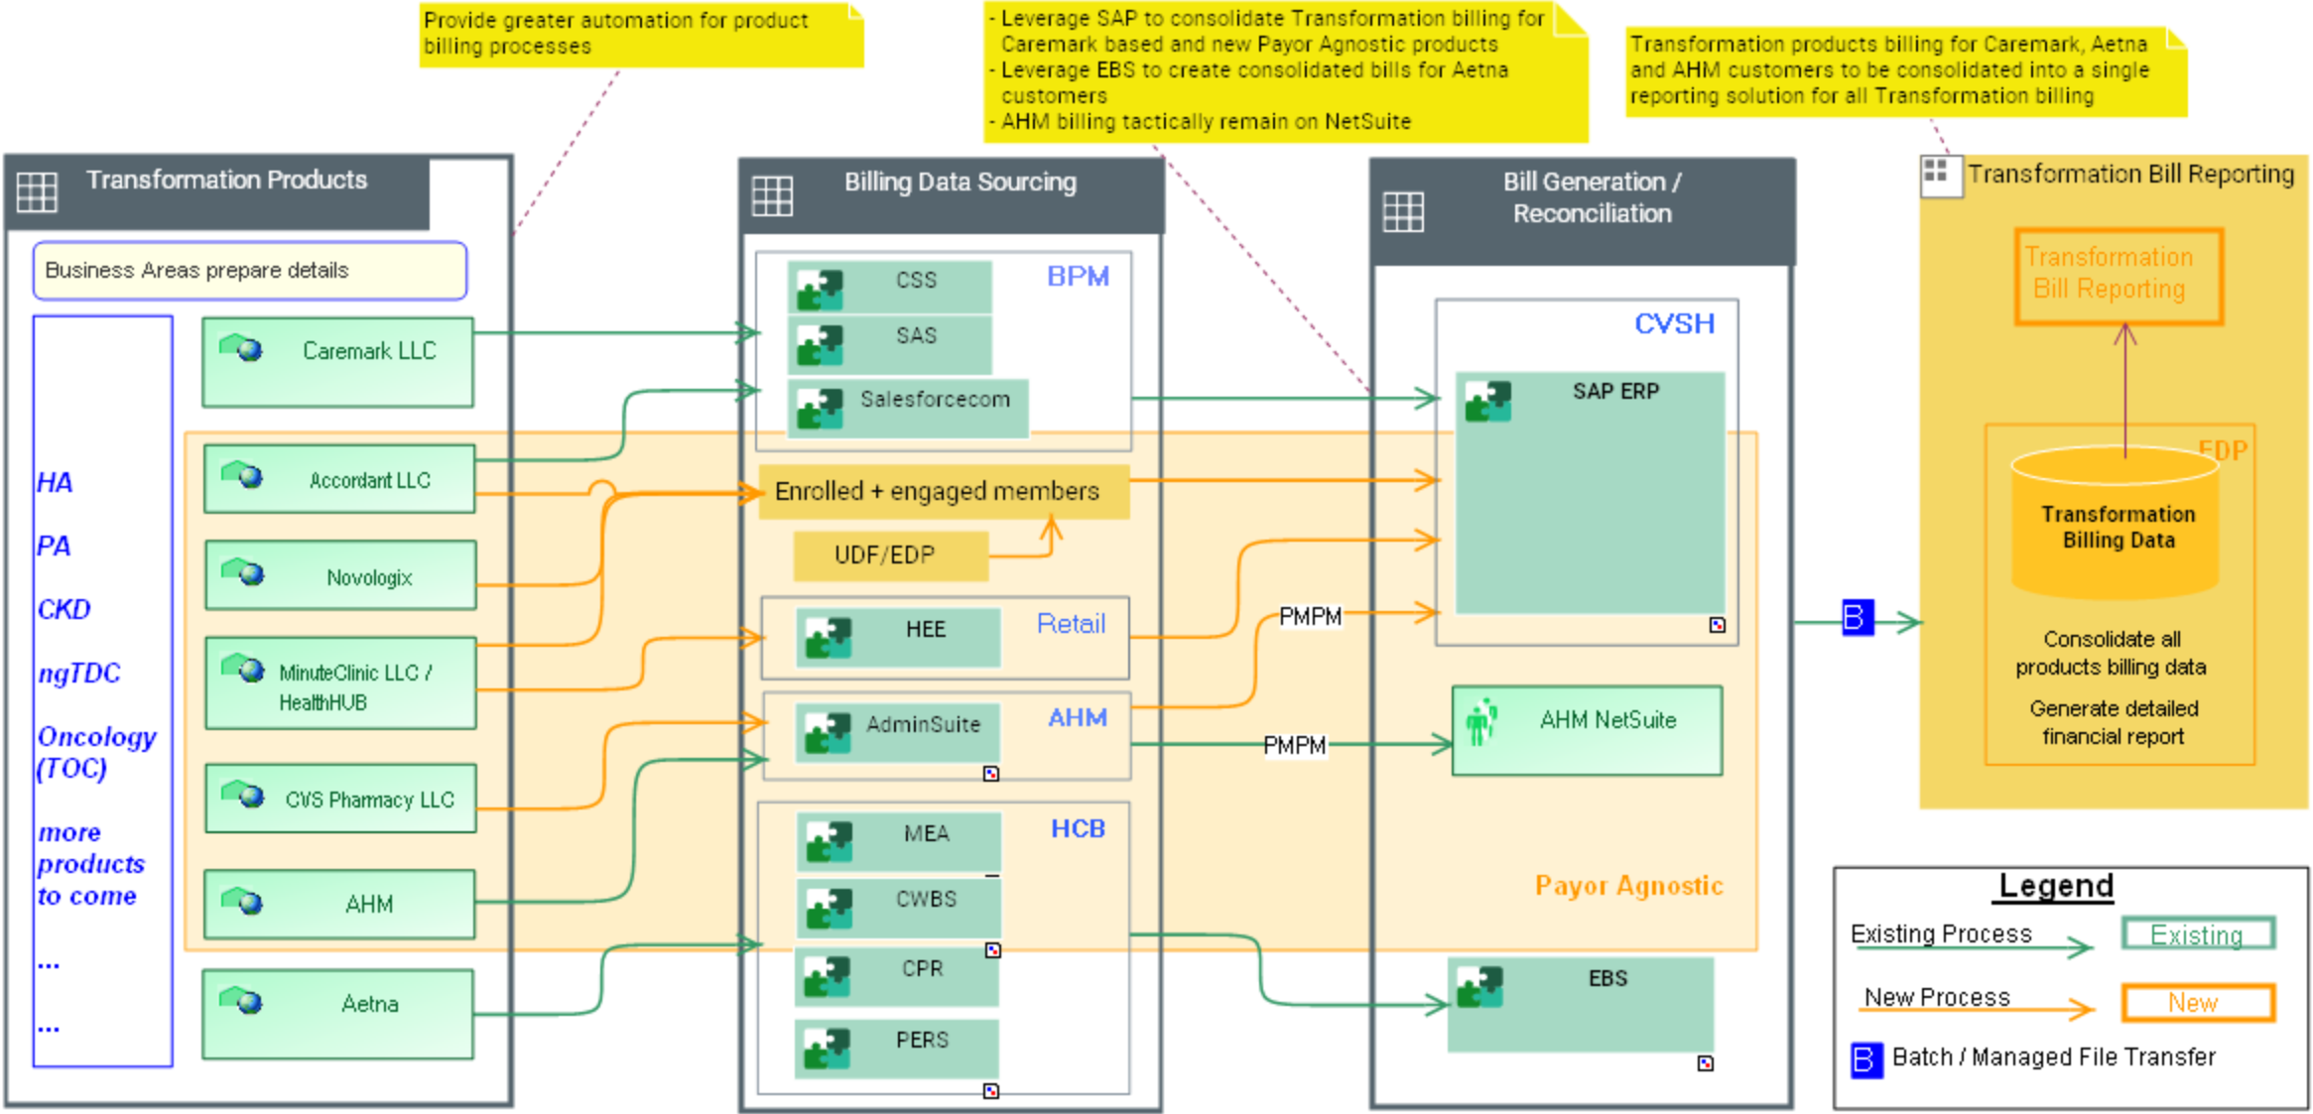
Transformation Product Billing Recommendation
A federated approach

Slide 7
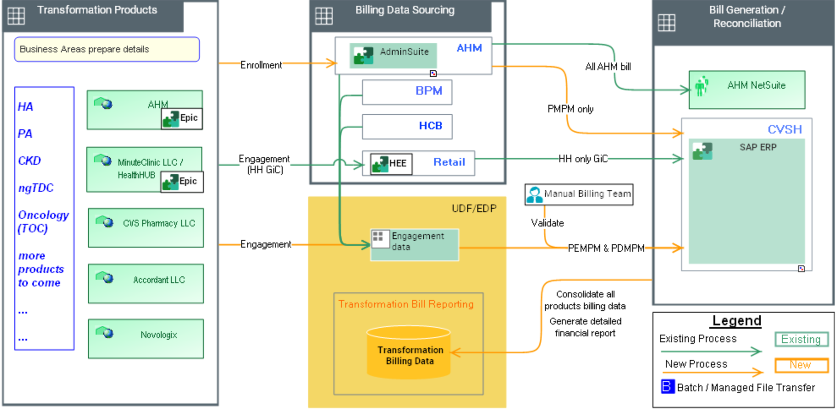
Transformation Payor Agnostic Billing Recommendation
Focusing on Payor Agnostic products

Slide 8
What does Success look like?
Minimize manual processes, create consistent and automated flow to improve accuracy and enable single bill for the Transformation products
Target State benefit
Potential Benefit
Description
Positive Outcomes
Improve Plan Sponsor / customer experience
All Transformation products on a single bill
Simplify customer experience through consolidated bill
Reducing complexity of billing process with fewer systems
Automation to reduce manual hand offs
Aaggregate all product reports to provide business insights
Time to market
Improved accuracy
Improved financial oversight
Streamline billing operation and improve insights

Slide 9

Next Steps - Recommendations
Leverage SAP billing capabilities for new Payor Agnostic products, automate manual processes and implement consolidated reporting solution for Transformation billing
Owner
Near-Term Action
(<6 months)
Long-Term Action
(>6 months)
Business
Establish billing guidelines to align Transformation product customers to appropriate billing legal entity
Establish Payor Agnostic billing team and define billing process workflows to optimize use of automation
Perform SAP setup for Payor Agnostic product billing
Perform go-live activity on SAP platform for Payor Agnostic billing
Establish reporting and reconciliation practices around Transformation billing
IT
Complete architectural roadmap for Transformation billing
Complete design for Payor Agnostic billing solution
Build integrations to support automation opportunities for Payor Agnostic billing
Establish consolidated Transformation billing reporting repository and dashboard
Load detailed customer billing data into the repository
Implement automation opportunities to reduce manual work across remaining billing teams

Slide 10
Into Action.

Slide 11
Participating Contacts
Role | Organization | Yasin Turkcan
Business contact | Transformation | Yasin Turkcan, Sandie Xu, Scott Moule,
 | Retail / CVS Pharmacy LLC, HealthHub+MC? | Lindsey Aubin, Patricia Fahey
 | PBM / Novologix, Accordant? HCB AHM | John Shamshoian, Faye (Ufei) Chan Allison Holdaway, John Pascavage, Ryan Davis, Amy Janos Miriam Ferreira, Kim Bilas,
IT / Finance | IT/Transformation | Carolyn Scholvinck,
 | Finance
 | Enterprise SAP | Gopinath Pariyaram, Kray Arnold, Diane Bourque
Architecture Lead | Technology Architecture & Innovation | Ravi Vangala, Kiran Paladugu John Pierce, Lala Liu
Architecture SME’s |  | Paul Le Clair
IT Support
Other | ? Products | Lauren Freeman

